Slide 1
COWTHEHERO GAME PROJECT
Lee Deuk yun
Kim Min Geon
4조
Jeon Ji Bin
Choi Cheol Min
Lee In Jae

Slide 2
INDEX
Contribution
Brainstorming
Story
Item
Enemy
Stage

Slide 3
Contribution of Group 4
Sound&Font&PPT
Mapdesign
Present
Lee In Jae
Kim Min Geon
Lee Deuk Yun
Lee In Jae
Programming
Choi Cheol Min
Lee Deuk yun
SceneMaking
Character&ObjectDesign
Kim Min Geon
Jeon Ji Bin

Slide 4

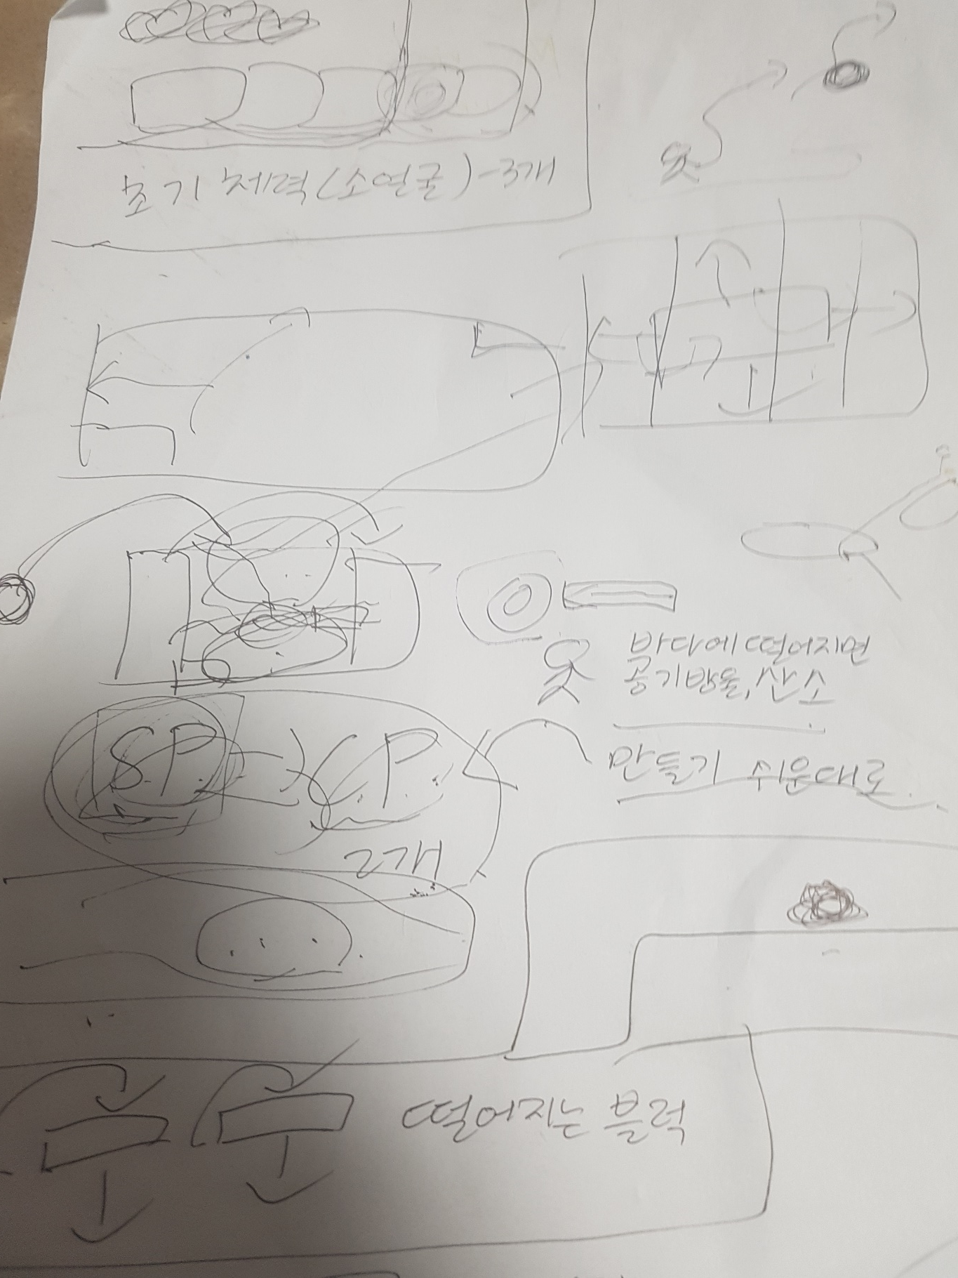
Brainstorming
Brainstroming

Slide 5
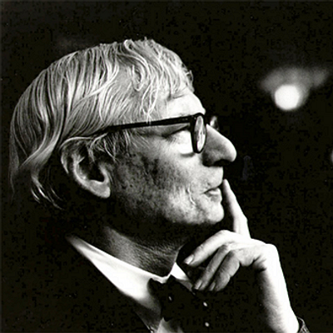
Brainstroming of these 3 Conditions
COW
THE
HERO
Reality
Actualize
Concept
Brainstroming

Slide 6
Brainstorming
Important
Things
Unimportant
Things
Brainstroming

Slide 7

About the Game
A cow is tired of working so he is escaping from the farm and rescuing friends. While he is escaping, he defeats enemy.
STORY

Slide 8

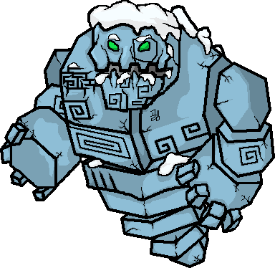

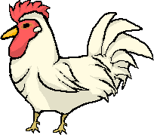

About the Game
Ice Golem
BIRD
BLACK COW
hermit crab
CHARACTERS
CHICKEN

Slide 9










About the Game
CheckPoint
Gun & Bullet
Spike
Carrot
Trampoline
Club
ITEMS
PetItem
Key

Slide 10
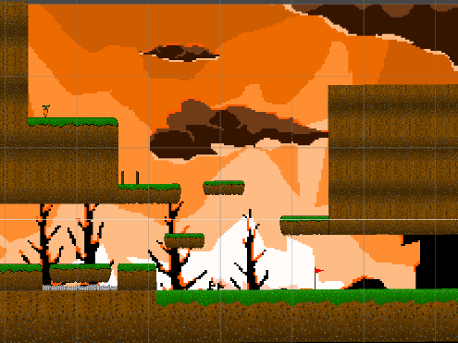
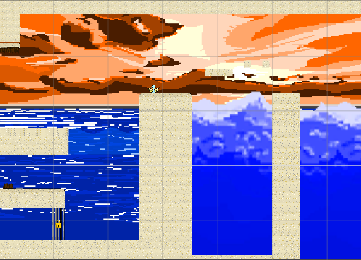
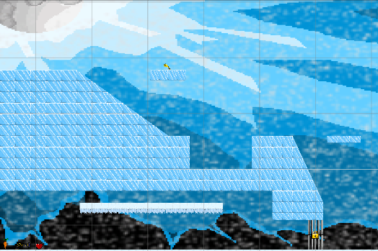
About the Game
FARM
BEACH
ICE
1
2
3
STAGE

Slide 11
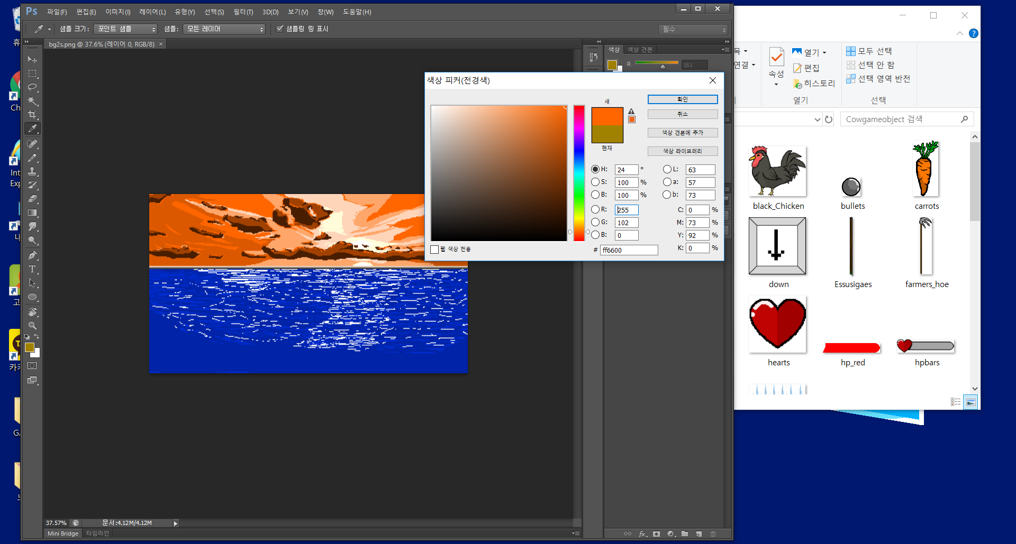
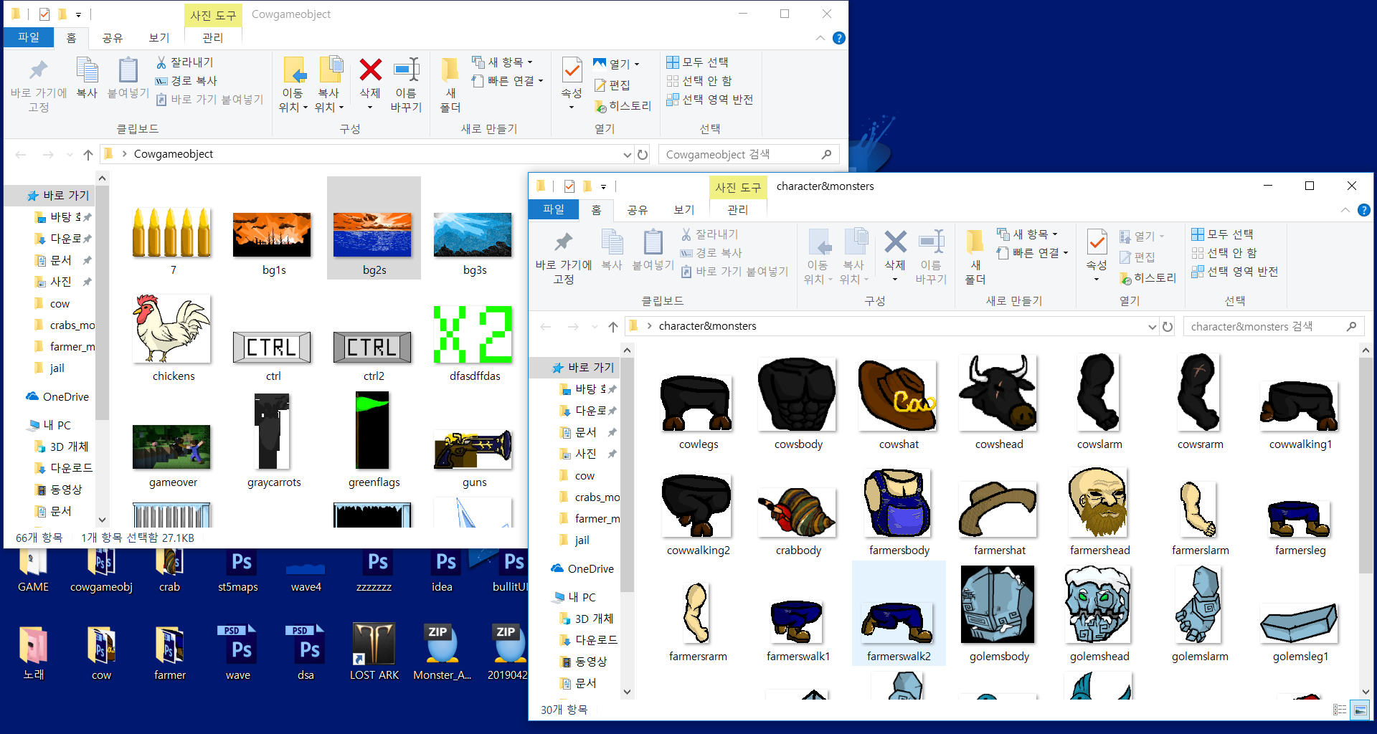
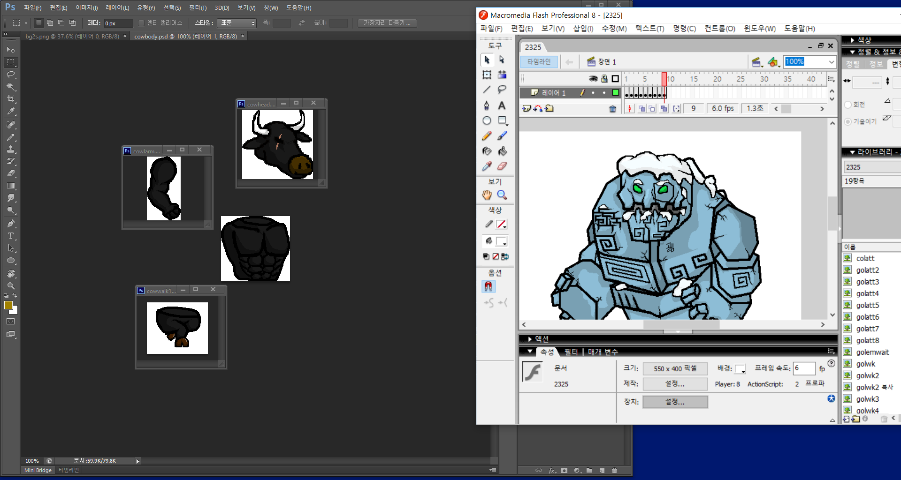

Slide 12
Sources
http://www.tapsmart.com/games/stardew-valley-live-quiet-country-life-farming-game/
-Opening-Scene Background
https://www.picswe.com/pics/minecarft-game-khung-cho-anh-dep-c5.html
-GameOver-Scene Background
https://www.1001fonts.com
-Every Fonts
Bgmstore.net
-Every BGMs

